Slide 1
English: Literature
Department of HSS, JIIT, Noida

Slide 2
Topics to be covered:
Literature: Definition & Meaning
Need to study Literature
English Language and Literature: Inter-relation
Approaches to study Literature
Literary Devices: Meaning
Literary Devices: Types
Resource to be consulted for further reading:
https://literarydevices.net/

Slide 3
Definition
Literature means those novels, short stories, plays and poems which convey their message by paying considerable attention to language which is rich and multilayered.

Slide 4
Why Study Literature
Literature has aesthetic and cognitive value.
The English language is deep-rooted in literature.

Slide 5
Aesthetic and Cognitive Values of Literature
For oft when on my couch I lie
Eyes raised, I see the moon so bright
Head bent, in homesickness I’m drowned
What is this life if full of care

Slide 6
The English language is deep-rooted in literature.
A little learning is a dangerous thing.
For fools rush in where angels fear to tread.
To err is human; to forgive, divine.
---Alexander Pope
The child is the father of man
---William Wordsworth
A pound of flesh—Shakespeare
catch-22 --- Joseph Heller

Slide 7
3 basic approaches
A language-based approach
A content-based approach
Literature for personal enrichment

Slide 8
How to Study Literature
By close reading
Be familiarized with some literary devices
Background information

Slide 9
What are literary devices?
Literary devices are techniques writers use to engage their readers beyond the literal meaning of the text.

Slide 10
Alliteration
Alliteration is derived from Latin’s “Latira”. It means “letters of alphabet”. It is a stylistic device in which a number of words, having the same first consonant sound, occur close together in a series.
Examples :
But a better butter makes a batter better.
Deep into that darkness peering, long I stood there wondering, fearing,
Doubting, dreaming dreams no mortal ever dared to dream before

Slide 11
Assonance
Assonance is a literary device in which the repetition of similar vowel sounds takes place in two or more words in proximity to each other within a line of poetry or prose. Assonance most often refers to the repetition of internal vowel sounds in words that do not end the same.
Examples :
He fell asleep under the cherry tree
Dumb luck
This little light of mine, I‘m going to let it shine

Slide 12
Hyperbole
A figure of speech in which exaggeration is used for emphasis or effect.
An extravagant statement or figure of speech not intended to be taken literally.
Examples :
I waited an eternity for summer to get here!
He could have slept for a year.
This book weighs a ton.

Slide 13


Imagery
Descriptive words or phrases that appeal to the 5 senses: sight, sound, touch, taste, and smell- creating a picture in the reader’s mind.

Slide 14

What Is an Image?
Listen to this excerpt of “The Shell” by James Stephens and imagine the scene he describes.
And straightway like a bell Came low and clear The slow, sad murmur of the distant seas,
. . . . . . . . . . . . . . . . . . . . . . . . . . . . . .
And in the hush of waters was the sound Of pebbles rolling round, For ever rolling with a hollow sound.
And bubbling sea-weeds as the waters go Swish to and fro Their long, cold tentacles of slimy grey.
—from “The Shell” by James Stephens

Slide 15

Quick Check
Which words appeal to the sense of hearing? sight? touch?
And straightway like a bell Came low and clear The slow, sad murmur of the distant seas,
. . . . . . . . . . . . . . . . . . . . . . . . . . . . . .
And in the hush of waters was the sound Of pebbles rolling round, For ever rolling with a hollow sound.
And bubbling sea-weeds as the waters go Swish to and fro Their long, cold tentacles of slimy grey.
—from “The Shell” by James Stephens

Slide 16
Quick Check
And straightway like a bell Came low and clear The slow, sad murmur of the distant seas,
. . . . . . . . . . . . . . . . . . . . . . . . . . . . . .
And in the hush of waters was the sound Of pebbles rolling round, For ever rolling with a hollow sound.
And bubbling sea-weeds as the waters go Swish to and fro Their long, cold tentacles of slimy grey.
—from “The Shell” by James Stephens
Which words appeal to the sense of hearing? sight? touch?
Hearing
Sight
Touch

Slide 17
Metaphor
A figure of speech in which two things are compared, usually by saying one thing is another, or by substituting a more descriptive word for the more common or usual word that would be expected.
Examples :
the world's a stage
he was a lion in battle
drowning in debt
a sea of troubles.

Slide 18
God looked around His garden
And saw an empty space
He then looked down upon this Earth
And saw your tired face
He knew that you were suffering
He knew you were in pain
He knew that you would never
Get well on Earth again
He knew the roads were getting rough
The mountains hard to climb
So he puts his arms around you and
Whispered Peace be Thine
He closed your weary eyelids
And lifted you for rest
This garden must be beautiful
He only takes the best
Written by an anonymous teenager.
metaphor

Slide 19
Personification
A figure of speech in which things or ideas are given human attributes.
Examples :
Dead leaves dance in the wind
Blind justice
Winter wrapped her cold fingers around me

Slide 20
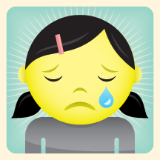
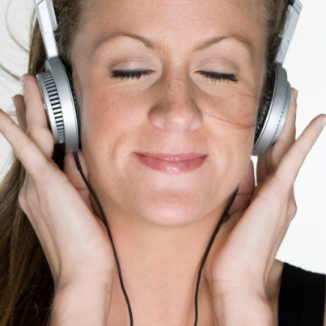
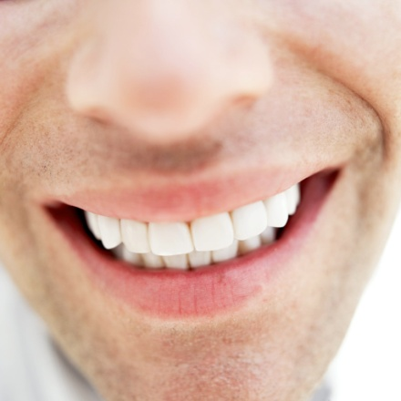
Repetition
A word or line that is repeated, usually to evoke an emotion or create a rhythm.

Slide 21
“There were so many important moments. If I’d missed the ticket, I wouldn’t be here. If I hadn’t gone to the show, I wouldn’t be here. If I hadn’t stuck around to see what Steve was up to, I wouldn’t be here. If I hadn’t stolen Madam Octa, I wouldn’t be here. If I’d said no to Mr. Crepsley’s offer, I wouldn’t be here.
A world of “ifs”, but it made no difference. What was done was done. If I could go back in time…” ~Cirque Du Freak by Darren Shan
Repetition

Slide 22
Rhyme
The occurrence of the same sound at the end of two or more words.
Examples :
cat / hat
desire / fire
steak / fake

Slide 23
English is a Pain! (Pane)
Rain, Reign, rein,
English is a pain.
Although the words
Sound just alike
The spelling’s not the same!
Bee, Be, B
I’d rather climb a tree
Than learn to spell
The same old word,
Not just one way, but three!
Sight, Site, Cite
I try with all my might.
No matter which
I finally choose,
It’s not the one that’s right!
There, Their, They’re,
Enough to make you swear.
Too many ways
To write one sound,
I just don’t think it’s fair!
To, Two, Too
So what’s a kid to do?
I think I’ll do
To live on Mars
And leave this mess with ewe! (you?)
By Shirlee Curlee Bingham
Rhyme

Slide 24
Simile
A simile is a figure of speech in which two essentially dissimilar objects or concepts are expressly compared with one another through the use of “like” or “as.”
She felt like a wilted flower.
The boy charged in the room like a bull!
This class is like a 3 ring circus!

Slide 25
The aliens have landed!
It’s distressing, but they’re here.
They piloted their flying saucer
Through our atmosphere.
They landed like a meteor
Engulfed in smoke and flame.
Then out they climbed immersed in slime
And burbled as they came.
Their hands are greasy tentacles.
Their heads are weird machines.
Their bodies look like cauliflower
And smell like dead sardines.
Their blood is liquid helium.
Their eyes are made of granite.
Their breath exudes the stench of foods
From some unearthly planet.
And if you want to see these
Sickly, unattractive creatures,
You’ll find them working in your school;
They all got jobs as teachers!
SimiLe
Kenn Nesbitt

Slide 26
PUNS
A pun is a literary device that is also known as a “play on words.” Puns involve words with similar or identical sounds but with different meanings. Their play on words also relies on a word or phrase having more than one meaning. Puns are generally intended to be humorous, but they often have a serious purpose as well in literary works.
When my algebra teacher retired, he wasn’t ready for the aftermath.
I recently spent money on detergent to unclog my kitchen sink. It was money down the drain.
Geometry is so pointless.
Romeo: “Not I, believe me. You have dancing shoes with nimble soles; I have a soul of lead” — From Romeo and Juliet.

Slide 27
The use of one thing to represent another Example: The dove is a symbol of peace. A red rose or red color stands for love or romance. Black is a symbol that represents evil or death. Lamb symbolizes innocence A flag stands for freedom
Symbolism

Slide 28
Paradox
A seeming contradiction.
Examples:
“It was the best of times. It was the worst of times.”
“You shouldn't go in the water until you know how to swim.”
“Be cruel to be kind.”-from Hamlet by Shakespeare

Slide 29
satire
A text or performance that uses irony, derision, or wit to expose or attack human vice, foolishness, or stupidity.

Slide 30
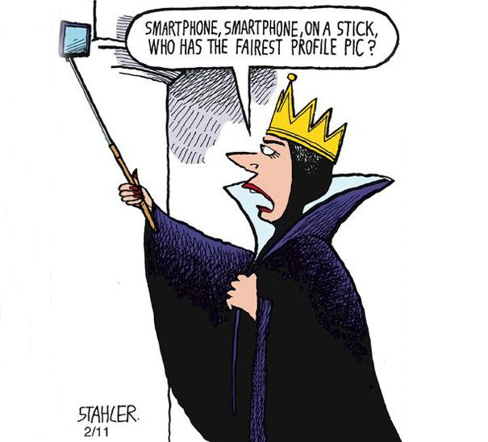

Slide 31
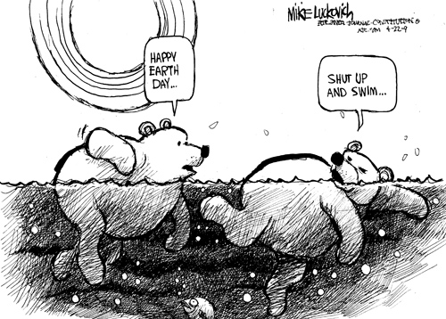

Slide 32
Irony
The expression of one's meaning by using language that normally signifies the opposite, typically for humorous or emphatic effect.
A state of affairs or an event that seems deliberately contrary to what one expects and is often wryly amusing as a result.

Slide 33
Examples:
A fire station burns down.
A character stepping out into a hurricane and saying, “What nice weather we're having!
“The Gift of the Magi”, by O. Henry is a story of two people, much in love, who are very poor and want to give a Christmas gift to one another. She is very proud of her long, beautiful hair and he is equally proud of his pocket watch. The irony comes in to play when she cuts and sells her hair to buy him a chain for his watch, and he sells the watch to buy her combs for her hair.

Slide 34
Soliloquy
A monologue in which a character expresses his or her thoughts to the audience and does not intend the other characters to hear them.
Examples:
“To be or not to be, that is the question.” from Hamlet written by Shakespeare

Slide 35
Learning & Relevance
Literary devices are techniques for effective communication.
They help in portraying a picture through words.
They are used to express ideas and improve the writing.
They can really enhance your work and create a deeper level of meaning that readers will enjoy decoding.

Slide 36
Let’s Revise!
Literature has __astheic_____and __cognitive_____ value.
There are___3___ approaches of studying literature.
Identify the literary devices:
Deep down, you're really shallow. Alliteratn & paradox
I'm drowning in a sea of grief. hyperblokr
The wind howled in the night. personif

Slide 37
References
https://slideplayer.com/slide/4796851/#:~:text=2%20Definition%20Literature%20means%20those,which%20is%20rich%20and%20multilayered.&text=Stylistics%20is%20such%20a%20way,understand%20how%20messages%20are%20conveyed.
https://slideplayer.com/slide/10206722/#:~:text=ARE%20LITERARY%20DEVICES%3F,LITERARY%20DEVICES%20ARE%20TECHNIQUES%20WRITERS%20USE%20TO%20ENGAGE%20THEIR%20READERS,Figurative%20Language%20Figurative%20Language.
https://literarydevices.net/
https://figurativelanguage.net/what-is-satire-definition-and-meaning.html
https://blog.reedsy.com/literary-devices/
https://examples.yourdictionary.com/examples-of-situational-irony.html

